Slide 1
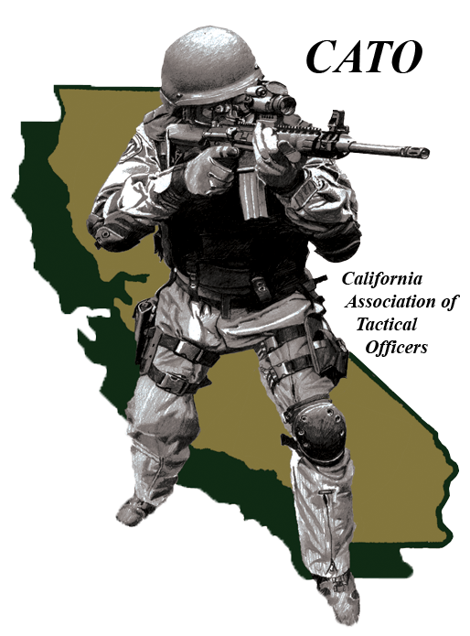
Anatomy of a Chemical Agents Program
Chemical Agent
CAI
INSTRUCTOR

Slide 2
Purpose:
Chemical Agent
To get You Thinking about your Team’s Chemical Agent Program
Start CAI with an Understanding of the Basic Components of a Chemical Agent Program
CAI
INSTRUCTOR

Slide 3
Break Out Group:
Chemical Agent
At the End of this Presentation, each CAI Team will Present the Following:
  What are you doing right in your programs?
  What is the worse thing in your programs?
  What are the first changes in your programs you will make?
  5 Minutes per Team
CAI
INSTRUCTOR

Slide 4
Responsibility and Philosophy:
  What is your C/A Program Responsible for?
    Tactical
    Mobile Field Force
    Fit Testing
  What is your C/A Program Philosophy?
    My “Boss” Hates Gas!
    Gas Formulas
      NTOA vs. CATO
  Past Program Philosophies
  Who Came Before You?
Chemical Agent
CAI
INSTRUCTOR

Slide 5
Instructor Cadre:
Chemical Agent
CAI
  The Quality of Instructors will make or Break your Program!
  How Selected?
  Recurrent Training
  Instructors that “Know their Business”
  “There is a time and a place to gas,
  you need to know what time it is!”
INSTRUCTOR

Slide 6
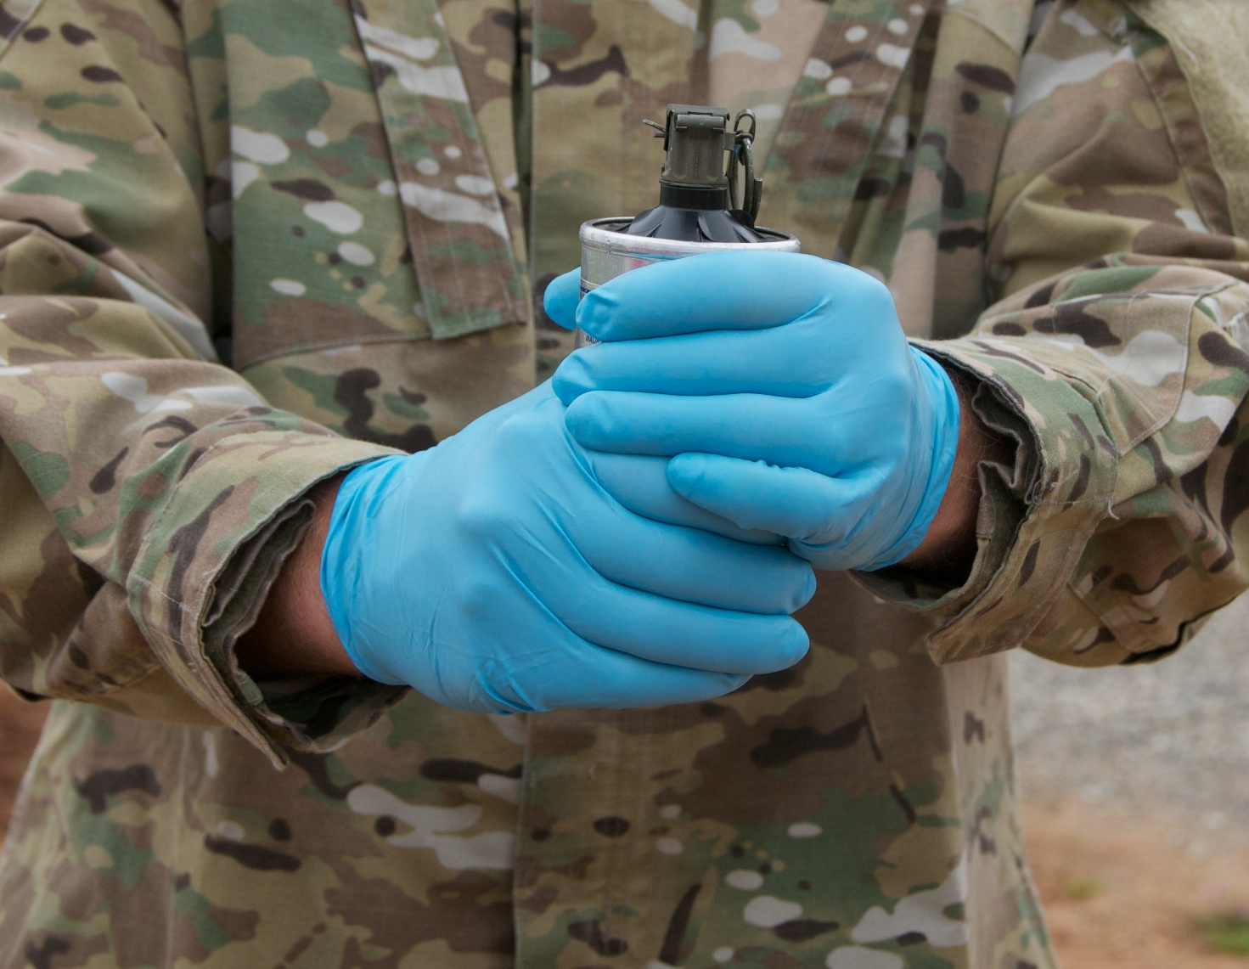
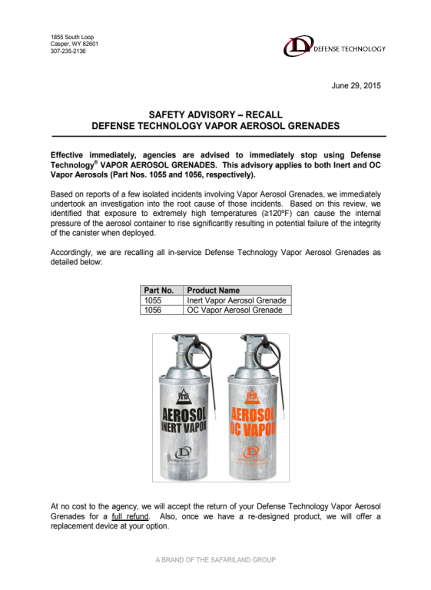
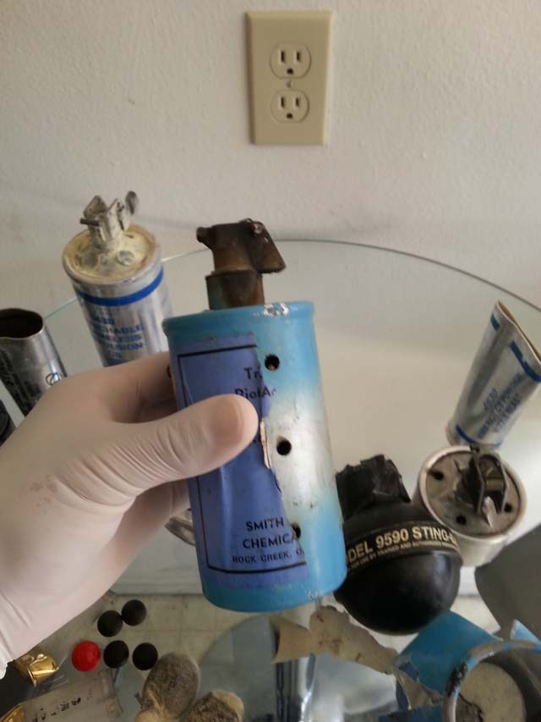
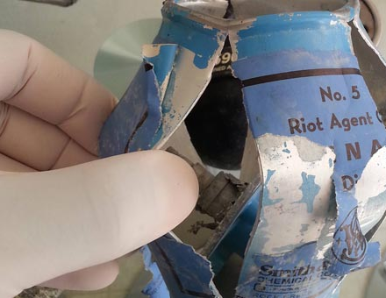

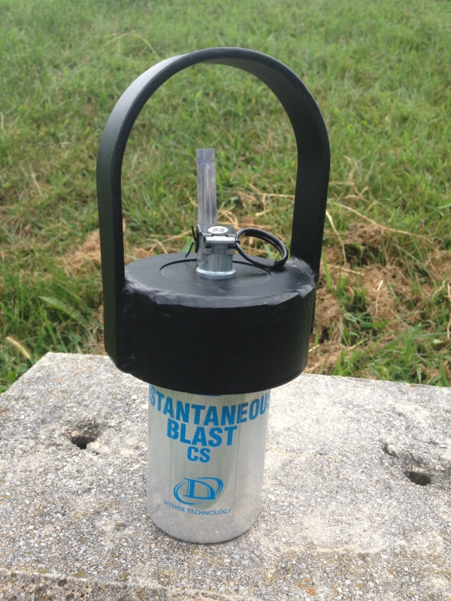
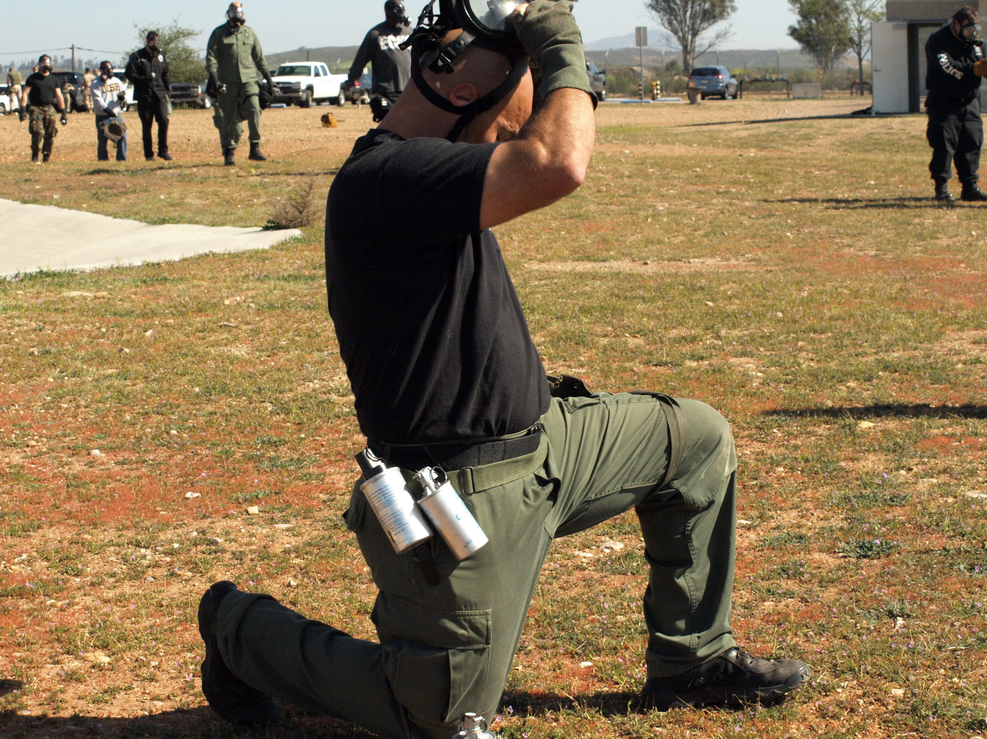
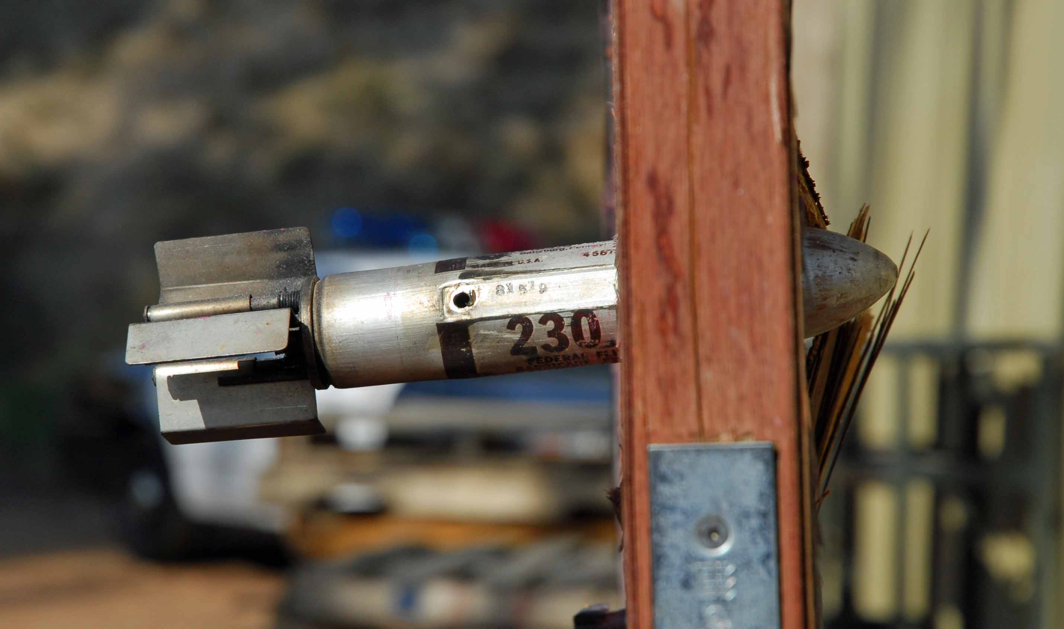
Knowing
Our
Business!

Slide 7
Policies and Procedures:
Chemical Agent
  How Modern are your Policies and Procedures?
  Who Authors these Polices and Procedures?
  Does your Program have Policies Related to:
    Patrol and Chemical Agents
    Different Polices for Patrol vs. Tactical Units
    Warning vs. No Warning
    Decon of Structures/Locations
CAI
INSTRUCTOR

Slide 8
Policies and Procedures:
Chemical Agent
  Does your Program have Policies Related to:
    Authorization Criteria
      Field Command Staff vs. Tactical Command staff
      Authorization Levels for Different Situations
      (i.e. patrol OC to crowd control to tactical barricade)
    What Chemical Agent should be used for a Given Situation
    Type of Chemical Agent – CN, OC, and/or CS
    How many Chemical Agent companies should your Agency buy from
CAI
INSTRUCTOR

Slide 9
Policies and Procedures:
Chemical Agent
  Does your Program have Policies Related to:
    Budget and Purchasing
    Munitions Rotation, Expired Munitions, and Destruction
    Reporting – Is Chemical Agent Deployment a Use of Force?
      Arrest/Incident Report, CIR, and Tracking
    APRs – Gas Masks
      Who Purchases
      Inspection/Maintenance
      Storage, Fit Testing, and OSHA Regulations
CAI
INSTRUCTOR

Slide 10
Policies and Procedures:
Chemical Agent
  Does your Program have Policies Related to:
    Storage
      Main Body Storage
      Vehicle
      Access to Munitions Locker(s)
    Decontamination – Should We Clean It Up?
      Structures
      Notices
      Follow Up
    After-Action
      Collect Expended Munitions & Book as Evidence (if possible)
      Photos / Videos
CAI
INSTRUCTOR

Slide 11
Training:
Chemical Agent
  Training Philosophy
    Understanding how you do Business as a Tactical Team
    To what Level are your Team Members Trained?
    Safety
  Having a “rethink” on Chemical Agent Training
      Frequency of Training
    Annual vs. Monthly vs. Quarterly
    Live Agent vs. Inert
    APRs
CAI
INSTRUCTOR

Slide 12
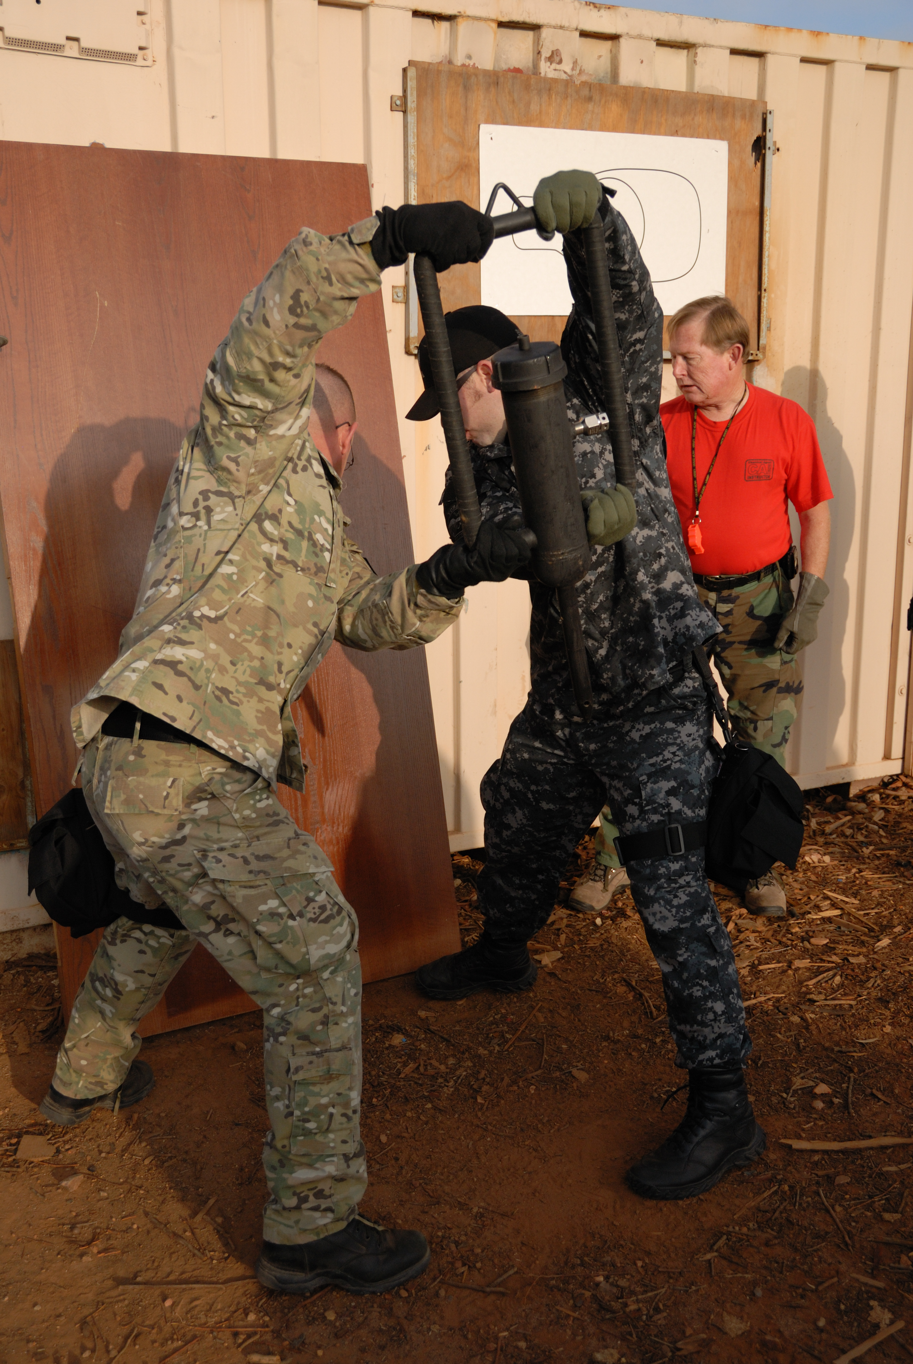
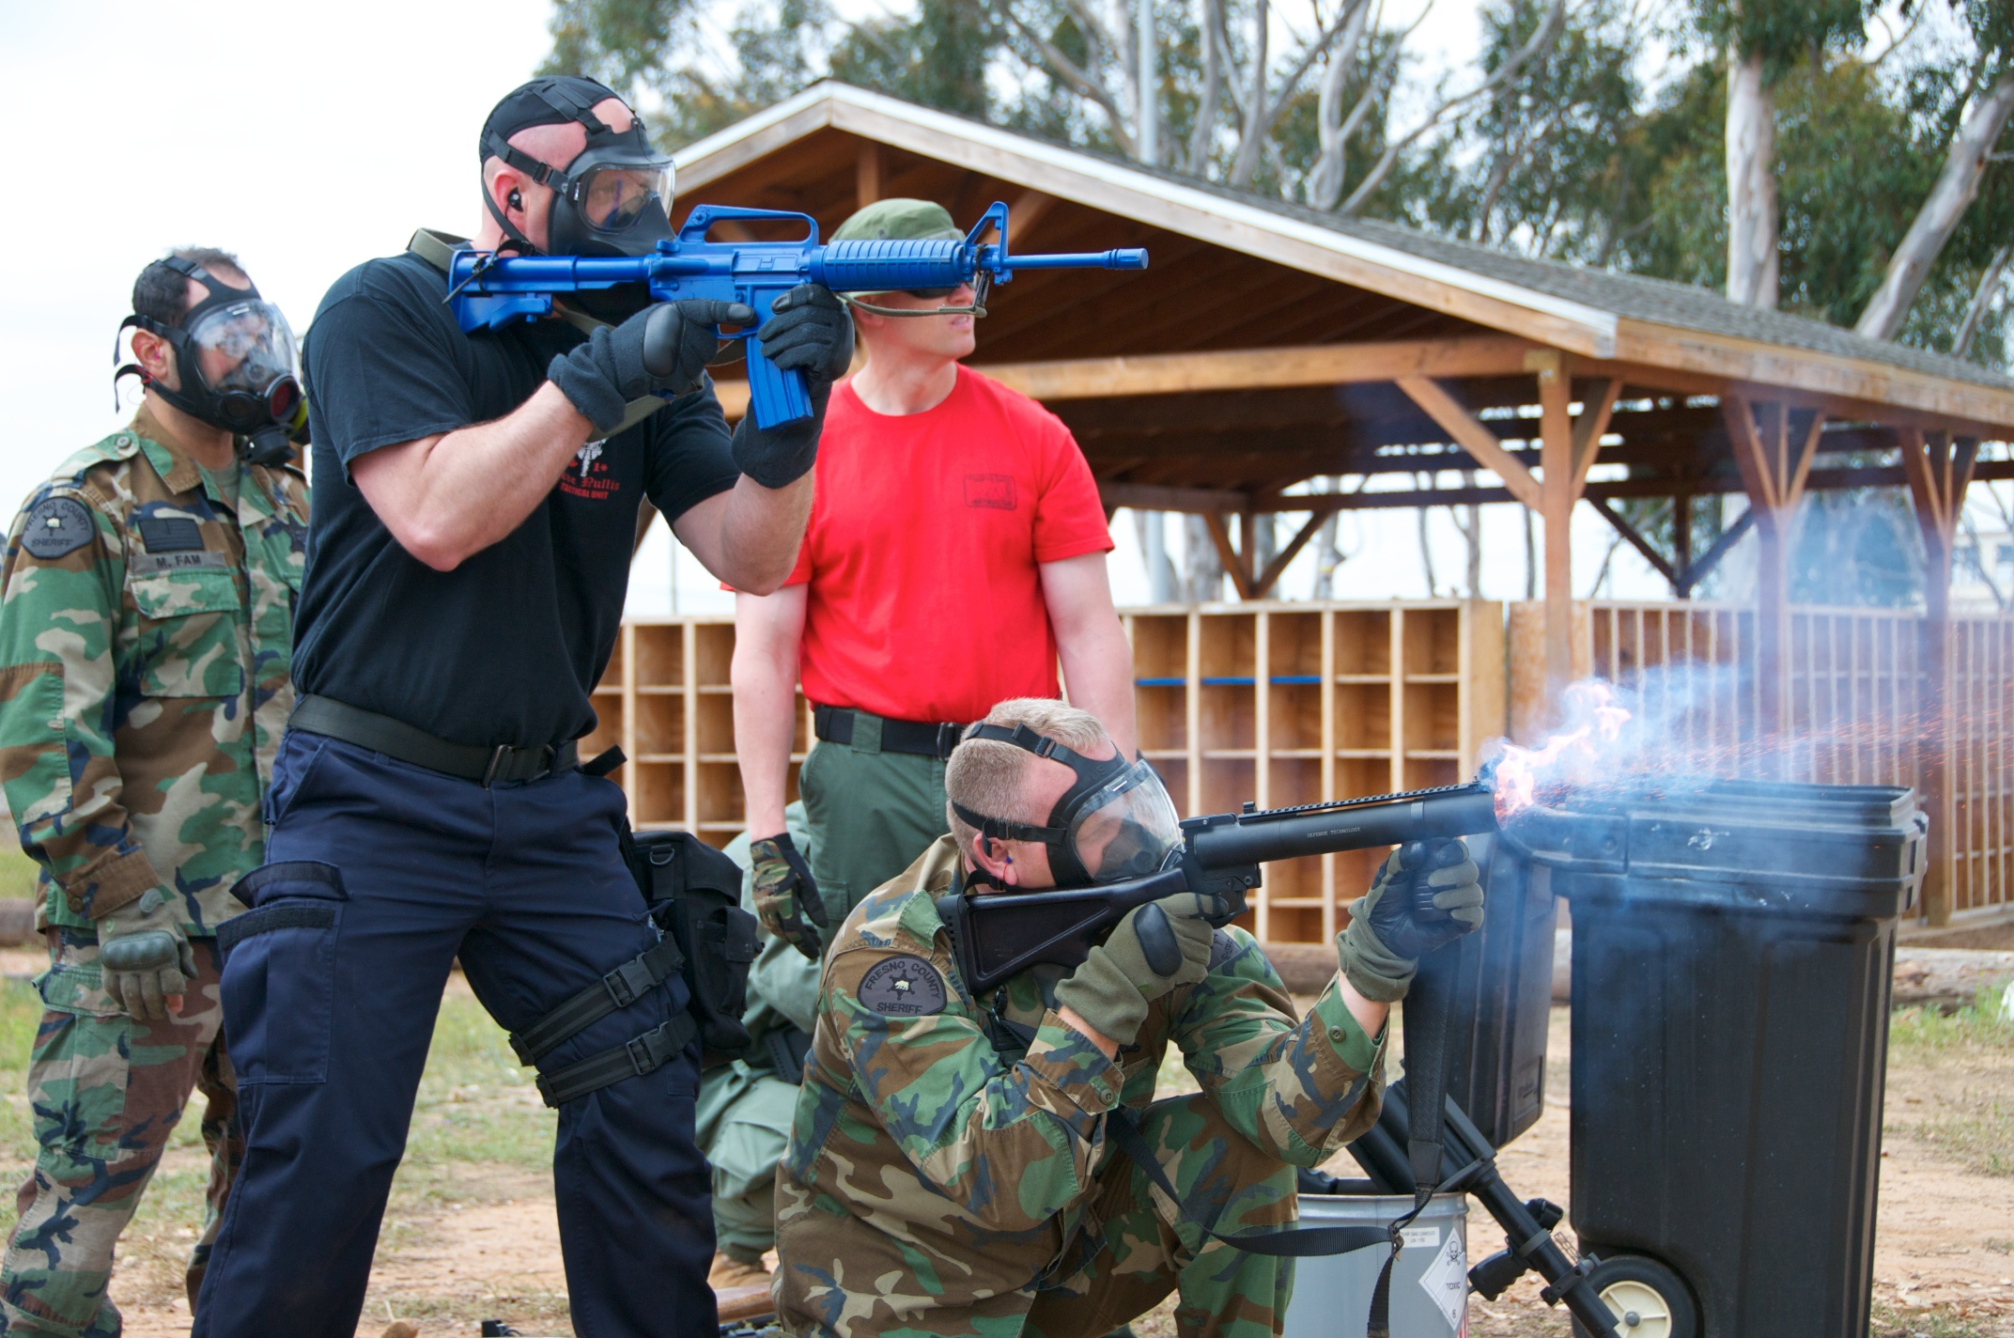
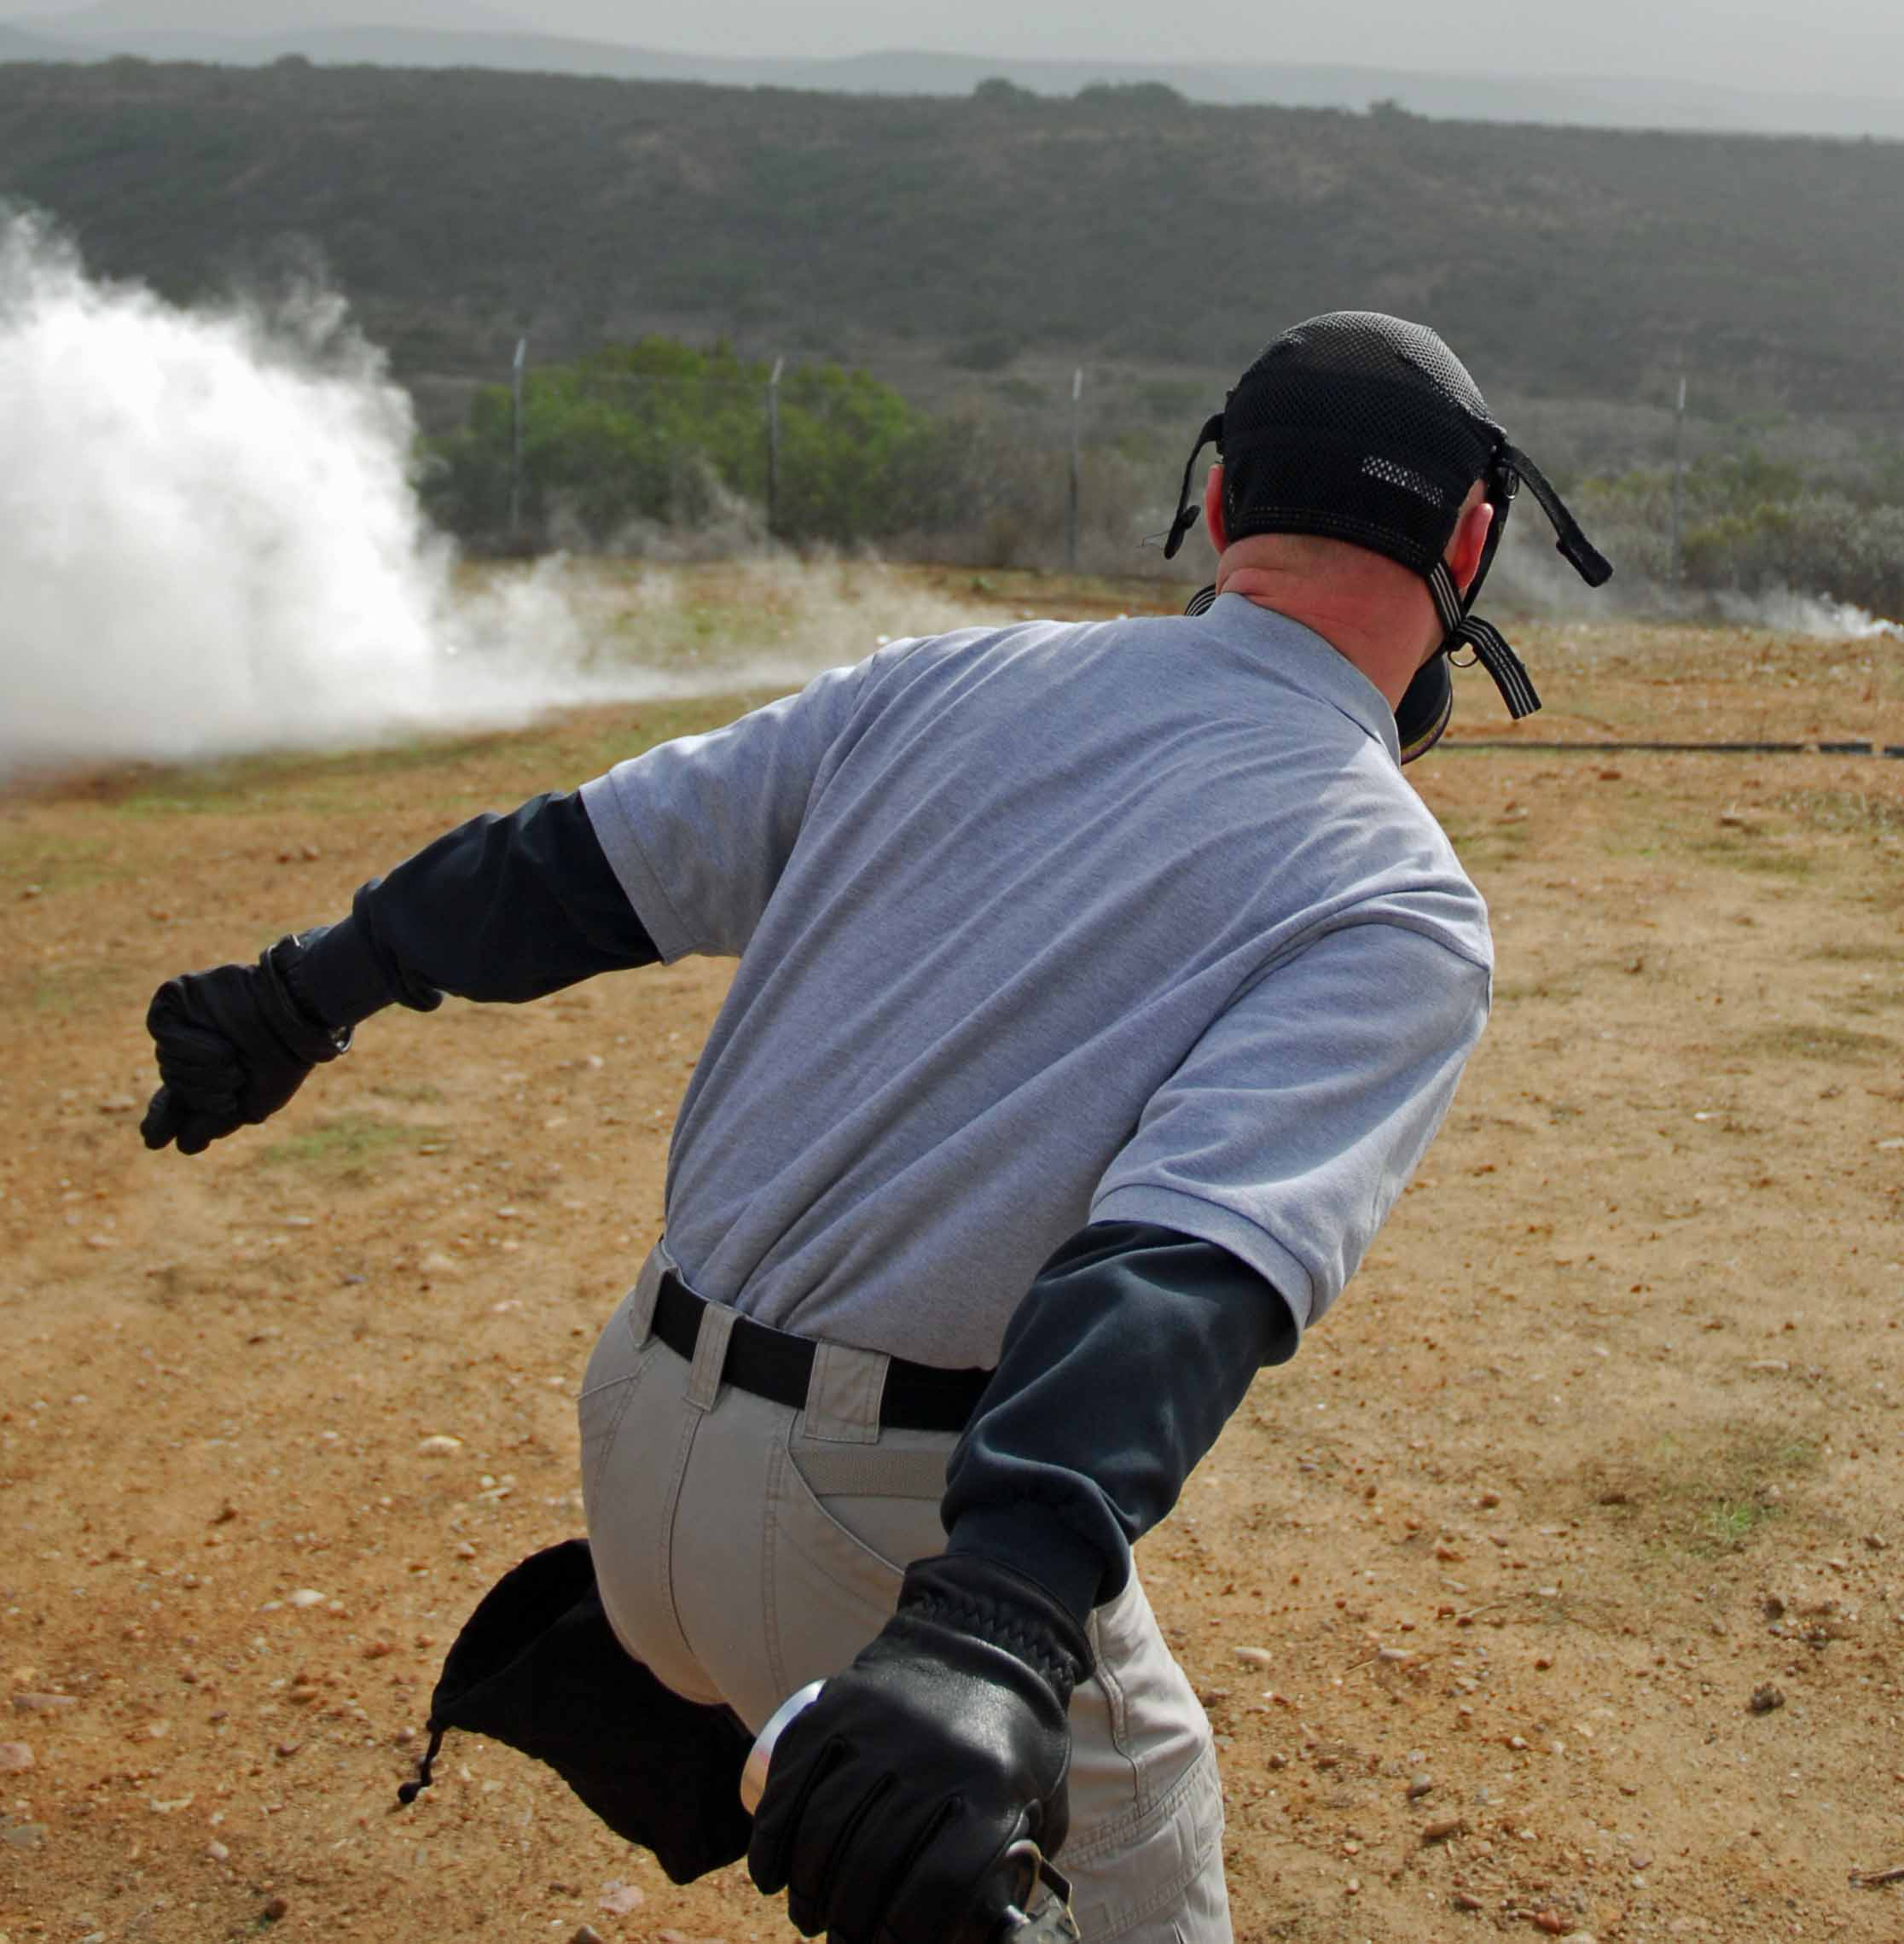

Building Towards the Future:
Chemical Agent
  Command Staff Open Invitation
  Command Staff Course Development
  Chemical Agent Surveys
  Networking
CAI
INSTRUCTOR

Slide 13
Questions or Comments

Slide 14
Breakout Group Exercise

